Slide 1
CREATING AND DEVELOPING YOUR FUTURE

Slide 2
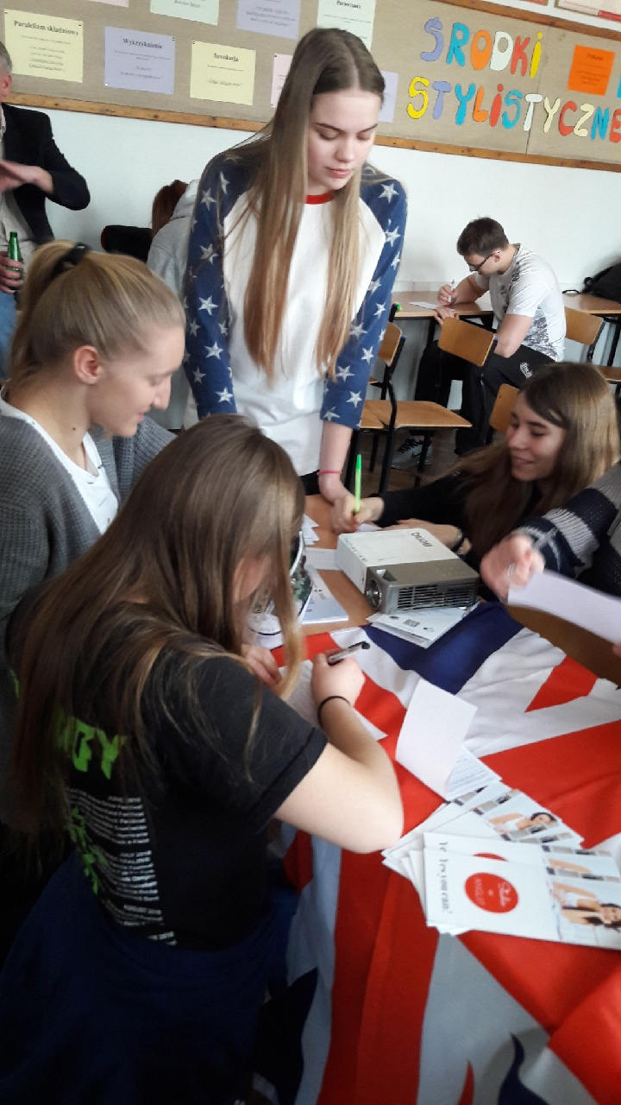
wHAT TO DO TO STUDY ABROAD?

Slide 3
A GUIDE FOR POLISH STUDENTS WHO WANT TO STUDY IN THE uK OR THE NETHERLANDS
Every year we invite some experts to make a brief presentation about the recruitment process in the UK and the Netherlands. Before you make a decision whether you would like to study in Poland or abroad it is strongly advisable to talk to a career adviser, your parents and complete some personality and aptitude tests.

Slide 4
The requirements
Polish Matura Exam, Basic level-90%, Extended level-60-80%
A Language certificate-IELTS-min. 6.0-6.5 out of 9.0
A covering letter (highly appreciated some voluntary work)
A portfolio for applicants of Art schools
If results are insufficient, you may be accepted to a foundation year.

Slide 5
costs
A recruitment fee-80 PLN in Poland, £23 for 5 diffrerent faculties
A tuition fee £ 9000 per year
A student loan may be paid back after a graduation

Slide 6
benefits
practical skills
communication skills
independence
language skills
More info www.studiujwanglii.pl

Slide 7
BiBLIOGRAPGHY
https://www.google.com/search?client=firefox-b-d&channel=crow&tbm=isch&q=image+business&chips=q:image+business,g_1:money:PJX0TD_AySw%3D&usg=AI4_-kT94GlTD07UBXIg6HxwOyLs3mxuMg&sa=X&ved=0ahUKEwjNvfHr15TjAhVJ1hoKHUJtDXEQ4lYITCgR&biw=1600&bih=776&dpr=1#imgrc=Bnefp6HPH88m0M:

