Slide 1
LONDON
Karolína Cigániková, Natália Gazdíková, Ema Jusková

Slide 2
1. Day
We went to westmister abbey, the houses of parliament, buckingham palace, St. James's park and in the afternoon we went to piccadilly circus and National gallery. Then we took doubledecker to london eye.
In westmister abbey were almost all the English rulers crowned there.
The Houses of Parliament is the seat of the two parliamentary houses of the United Kingdom: the House of Lords and the House of Commons.
Buckingham Palace is the London residence and administrative headquarters of the monarch of the United Kingdom.
St James's Park is park in the City of Westminster, in central London.
Piccadilly circus is a road junction and public space in london. It was built in 1819 to connect Regent Street with Piccadilly.
National gallery is an art museum in Trafalgar Square in the City of Westminster, in Central London.
London eye is a giant Ferris wheel on the South Bank of the River Thames in London. It is Europe's highest Ferris wheel, is the most popular paid tourist attraction in the United Kingdom

Slide 3
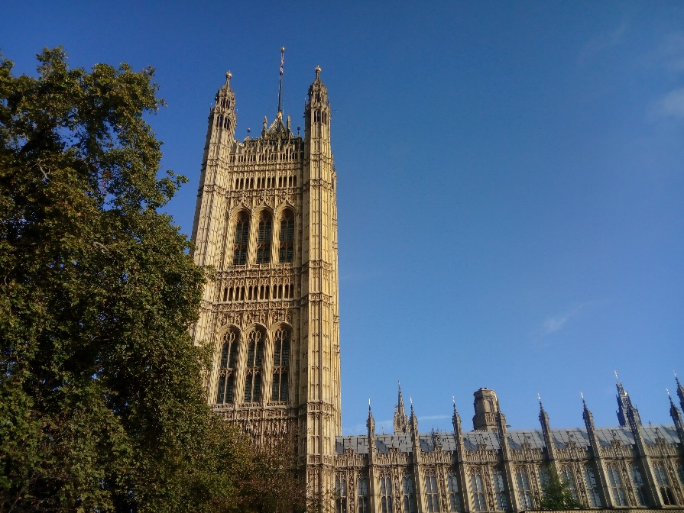
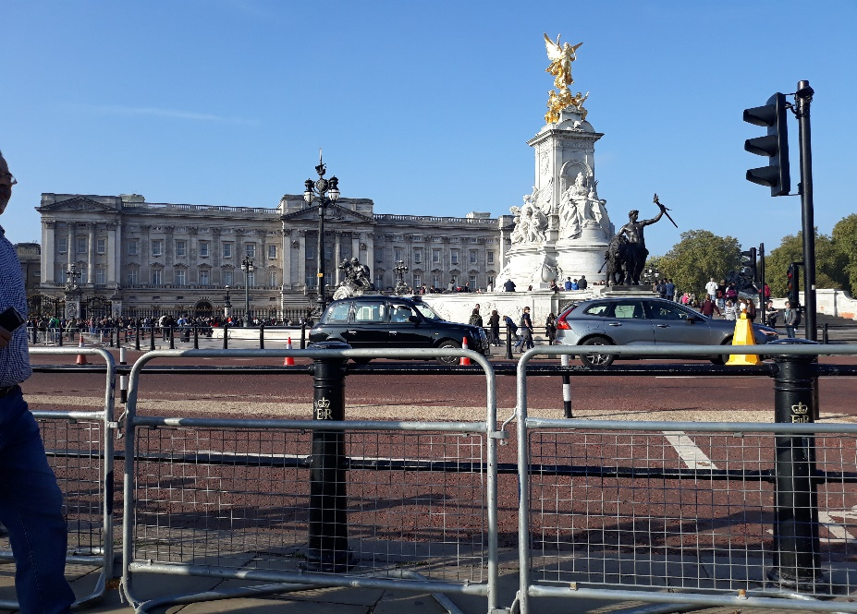
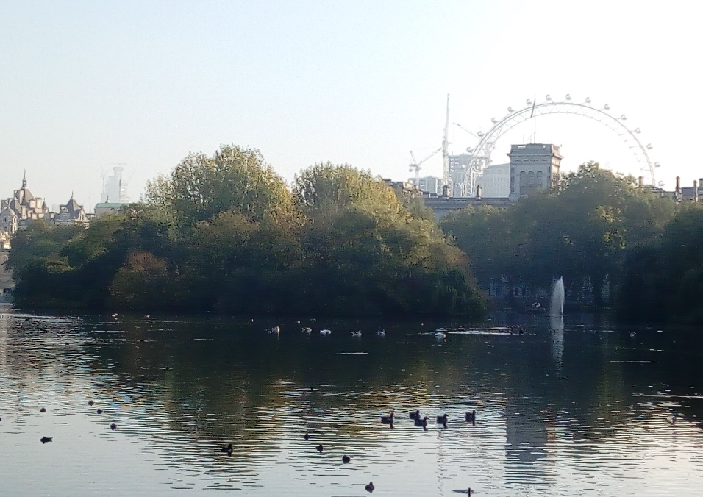
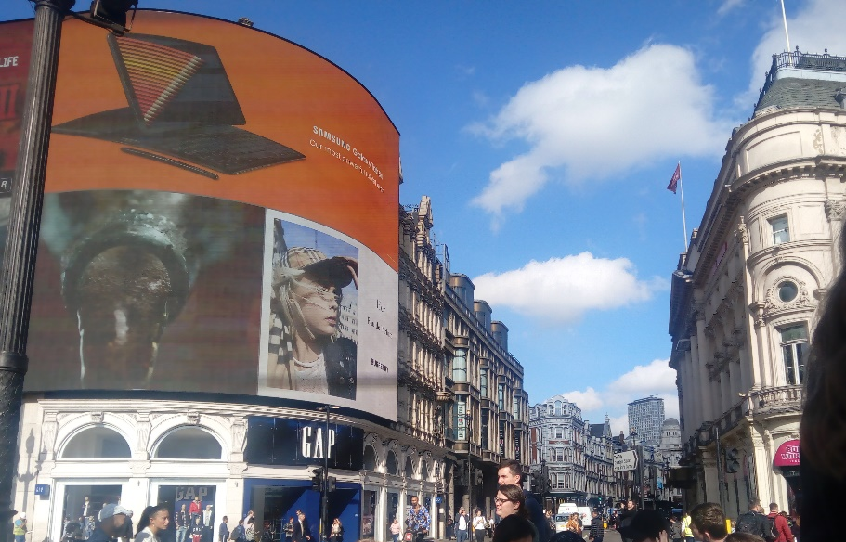
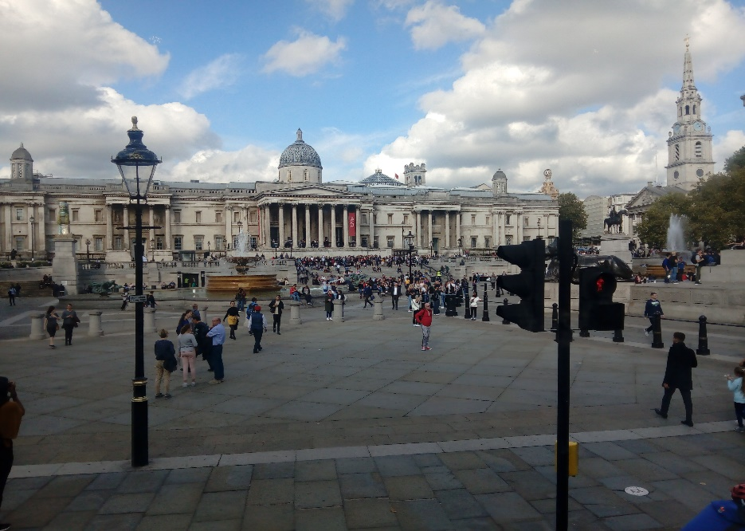
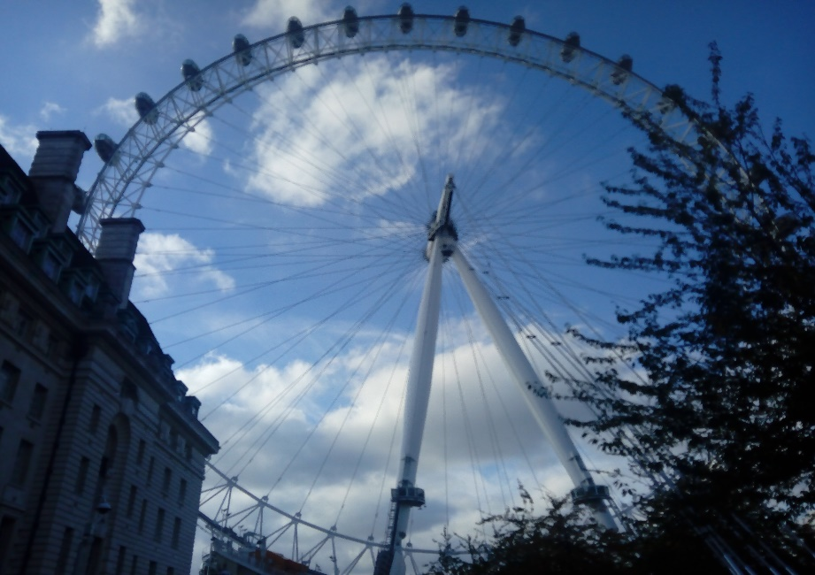
Houses of Parliament
Buckingham Palace
St. James's Park
Piccadilly Circus
National Gallery
London Eye

Slide 4
2. day
We went to natural history museum, science museum and in the afternoon we went to hyde park, Fountain of Princess Diana, oxford street
National history museum is one of three major museums in London, the others being the Science Museum and the Victoria and Albert Museum
Science museum is a major museum on Exhibition Road in South Kensington
Hyde park is a major park in Central London. It is the largest of four Royal Parks
Fountain of princess Diana is a memorial in London dedicated to Diana, Princess of Wales, who died in a car crash in 1997
Oxford street is a major road in the City of Westminster. It is Europe's busiest shopping street

Slide 5
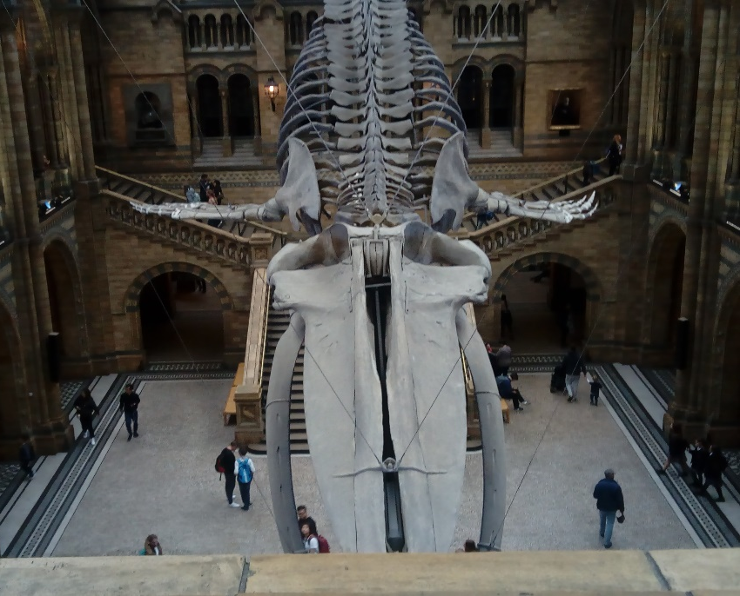
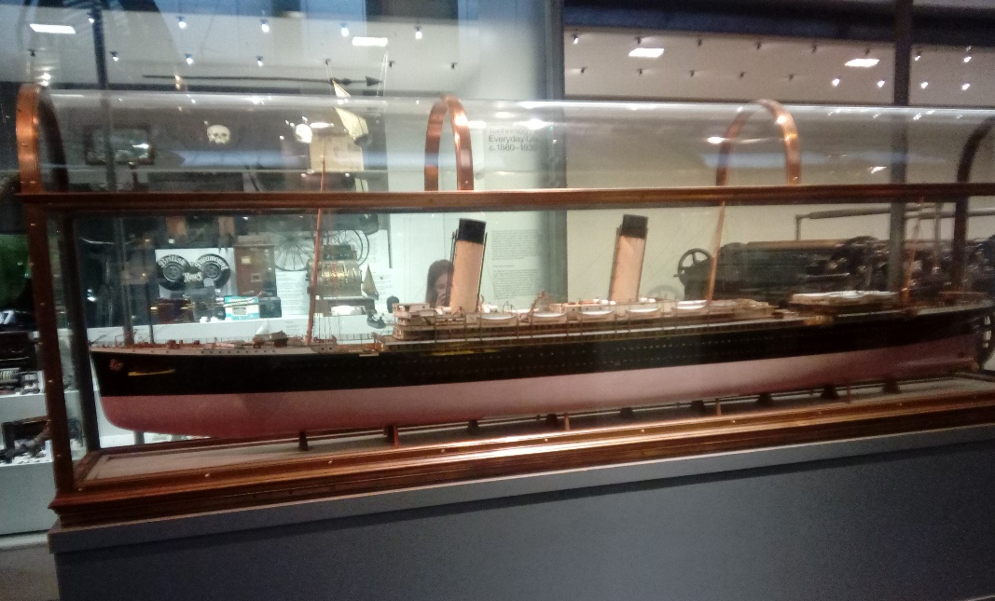
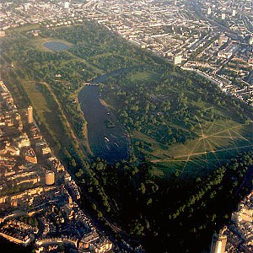
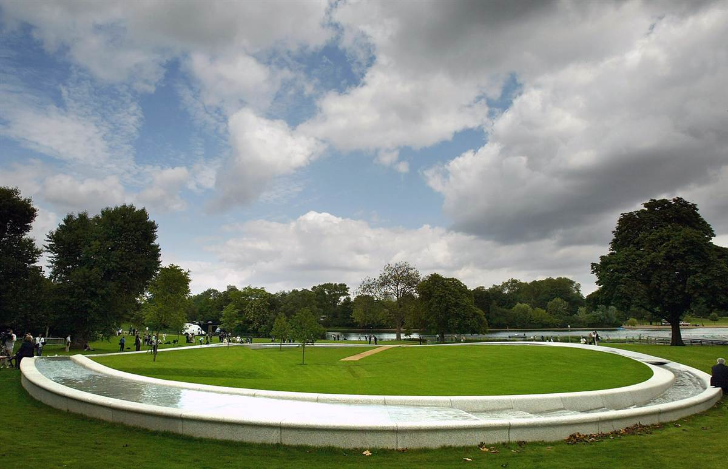
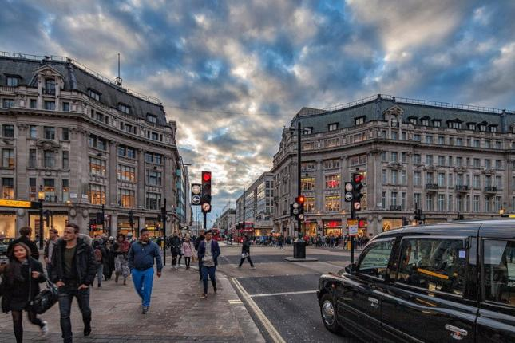
Natural History Museum
Science Museum
Hyde Park
Fountain of Princess Diana
Oxford Street

Slide 6
3. day
We went to madame tussaud´s, St Paul's Cathedral , tower of london and tower bridge
Madame tussaud´s is a wax museum in London. It was founded by wax sculptor Marie Tussaud.
St Paul's Cathedral is an Anglican cathedral, the seat of the Bishop of London.
Tower of london is a historic castle located on the north bank of the River Thames in central London. It was built by William the Conqueror in 1078.
Tower bridge is a combined bascule and suspension bridge in London. The bridge crosses the River Thames close to the Tower of London and has become an iconic symbol of London.

Slide 7
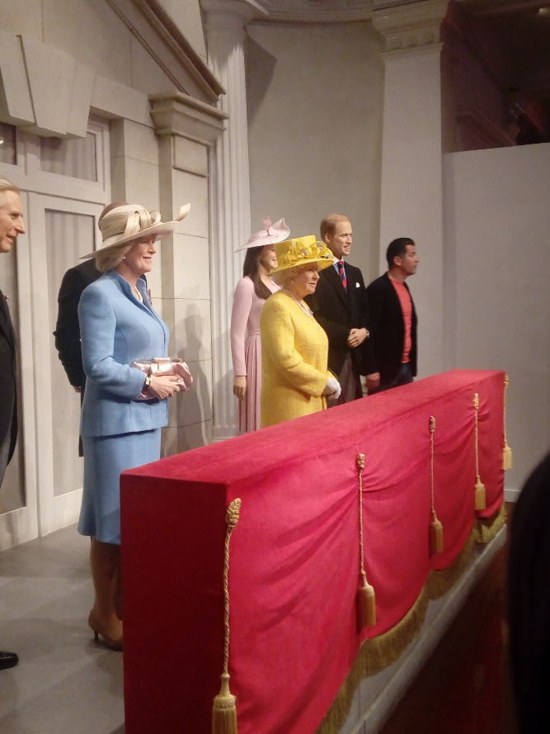
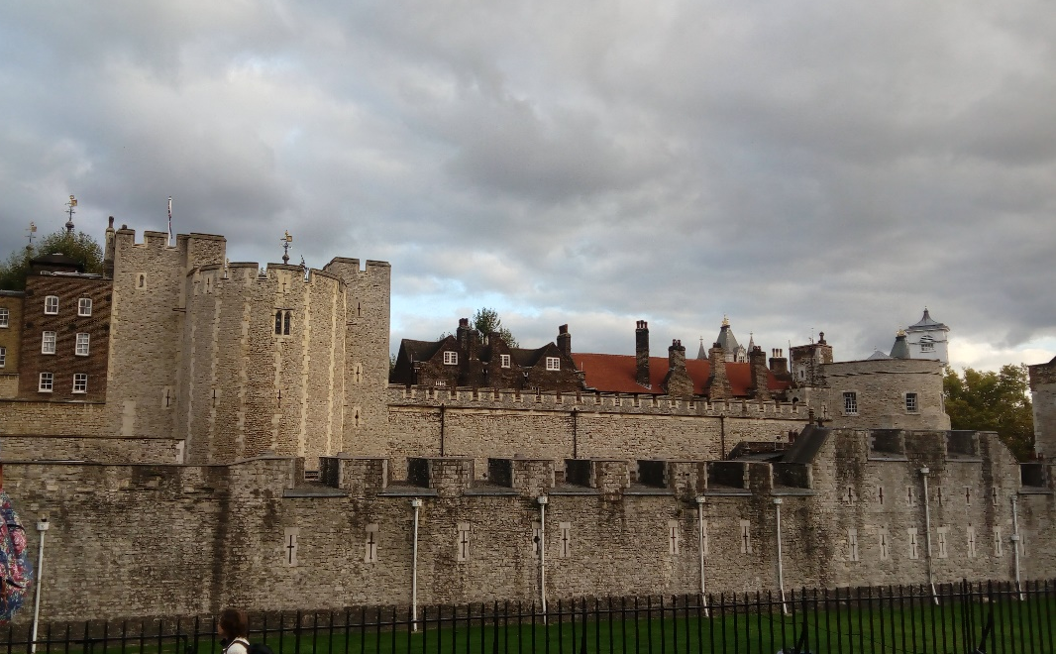
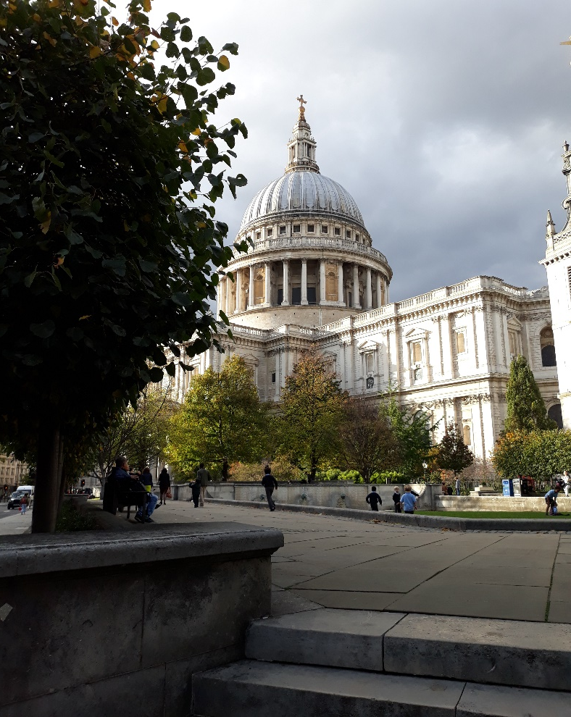
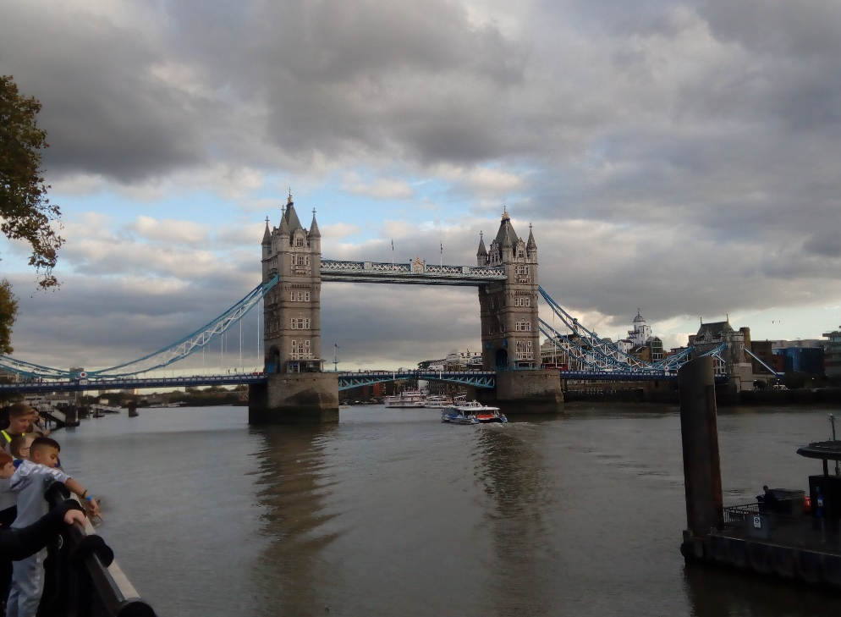
Tower of London
Madame Tussaud´s
St. Paul´s Cathedral
Tower Bridge

Slide 8
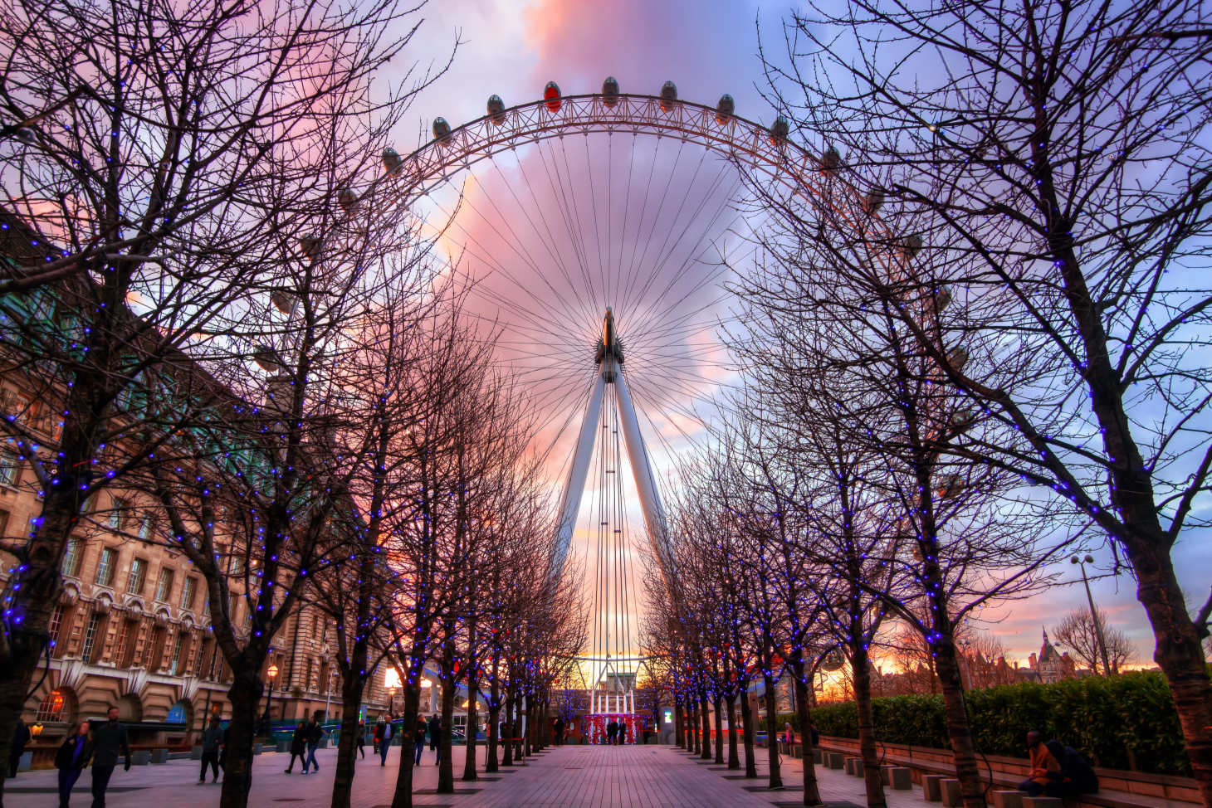
Ďakujeme za pozornosť!

