Slide 1
London 2018
Vanesa Bušovská 7.C

Slide 2
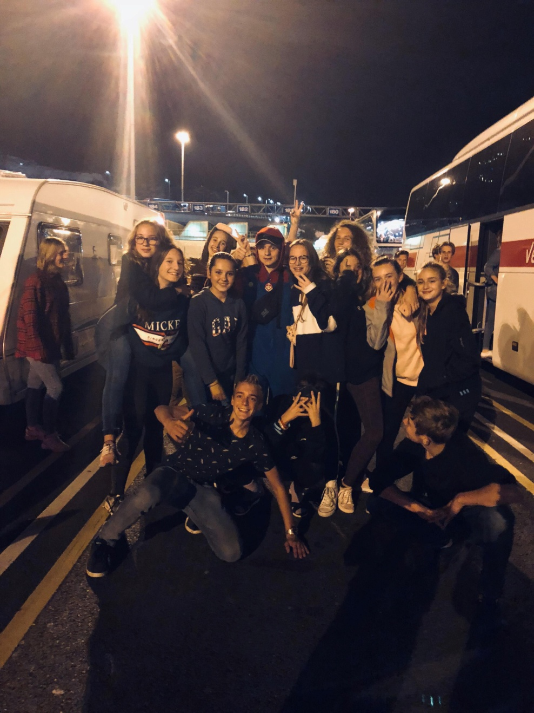
The road
My first trip to London.
We travelled for 26 hours.

Slide 3
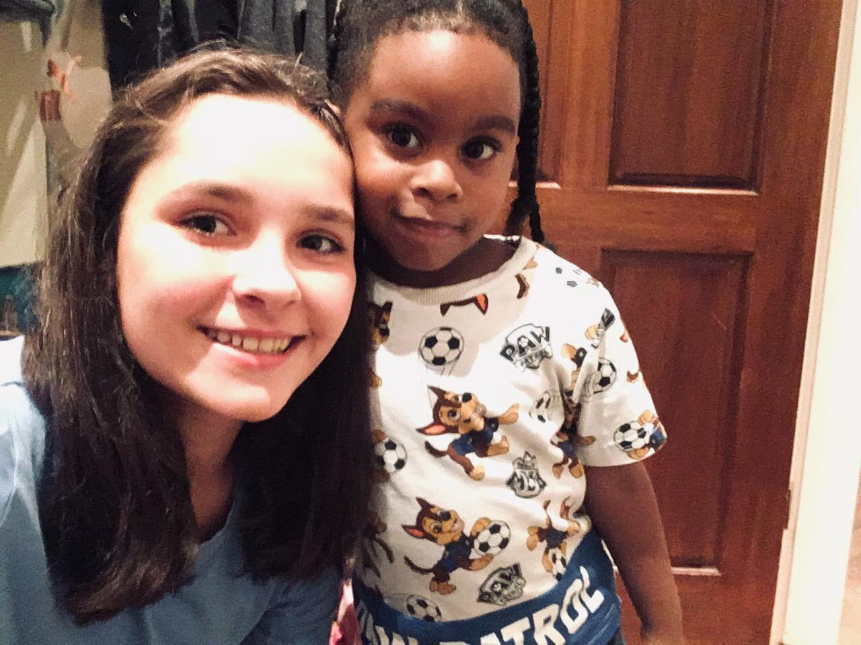
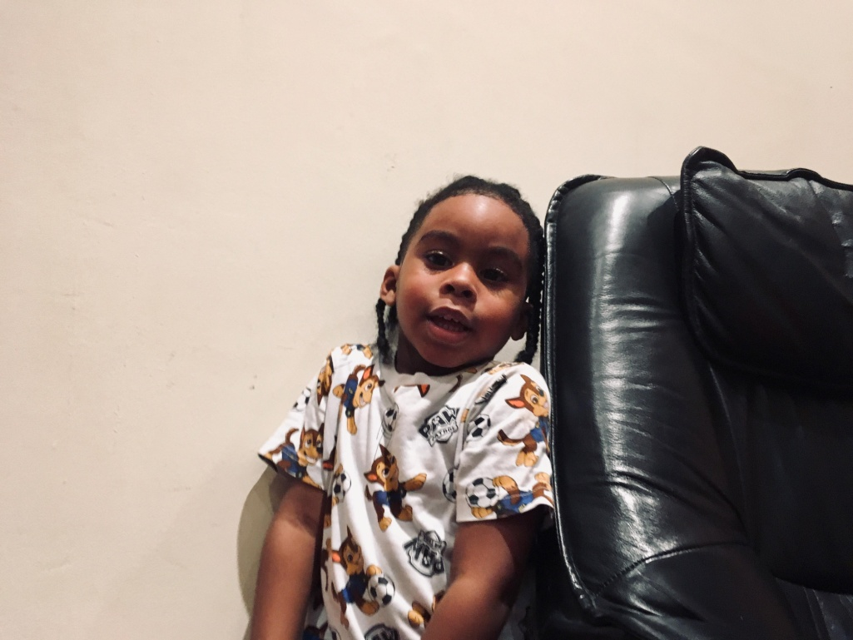
Family
Family was great.
There were parents, their daughter and her son.

Slide 4
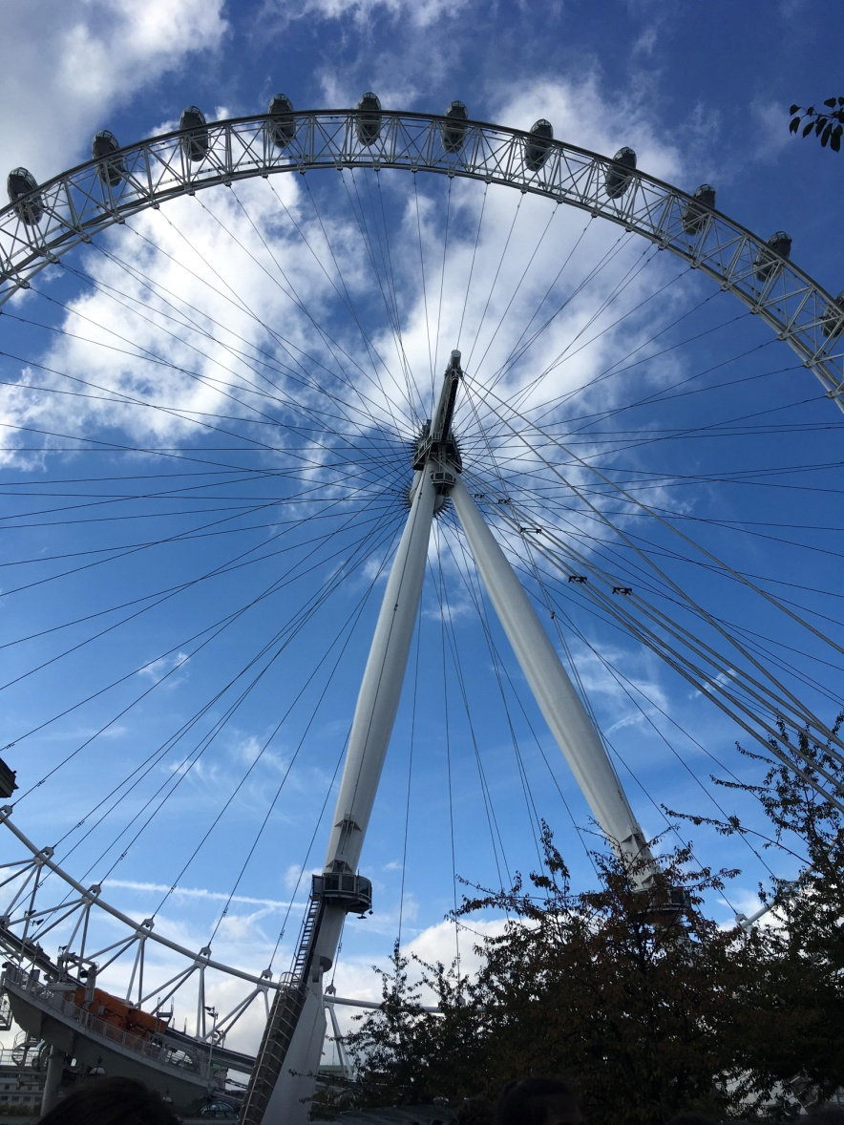
We saw:
Big Ben, Parliament Square, Westminster, Park sv. Jakuba, Buckingham Palace, Leicester Square, Chinatown, London Eye, Science and History museum, Kensington gardens, Madame Tussauds, Cathedral st. Paul and Tower Bridge.

Slide 5
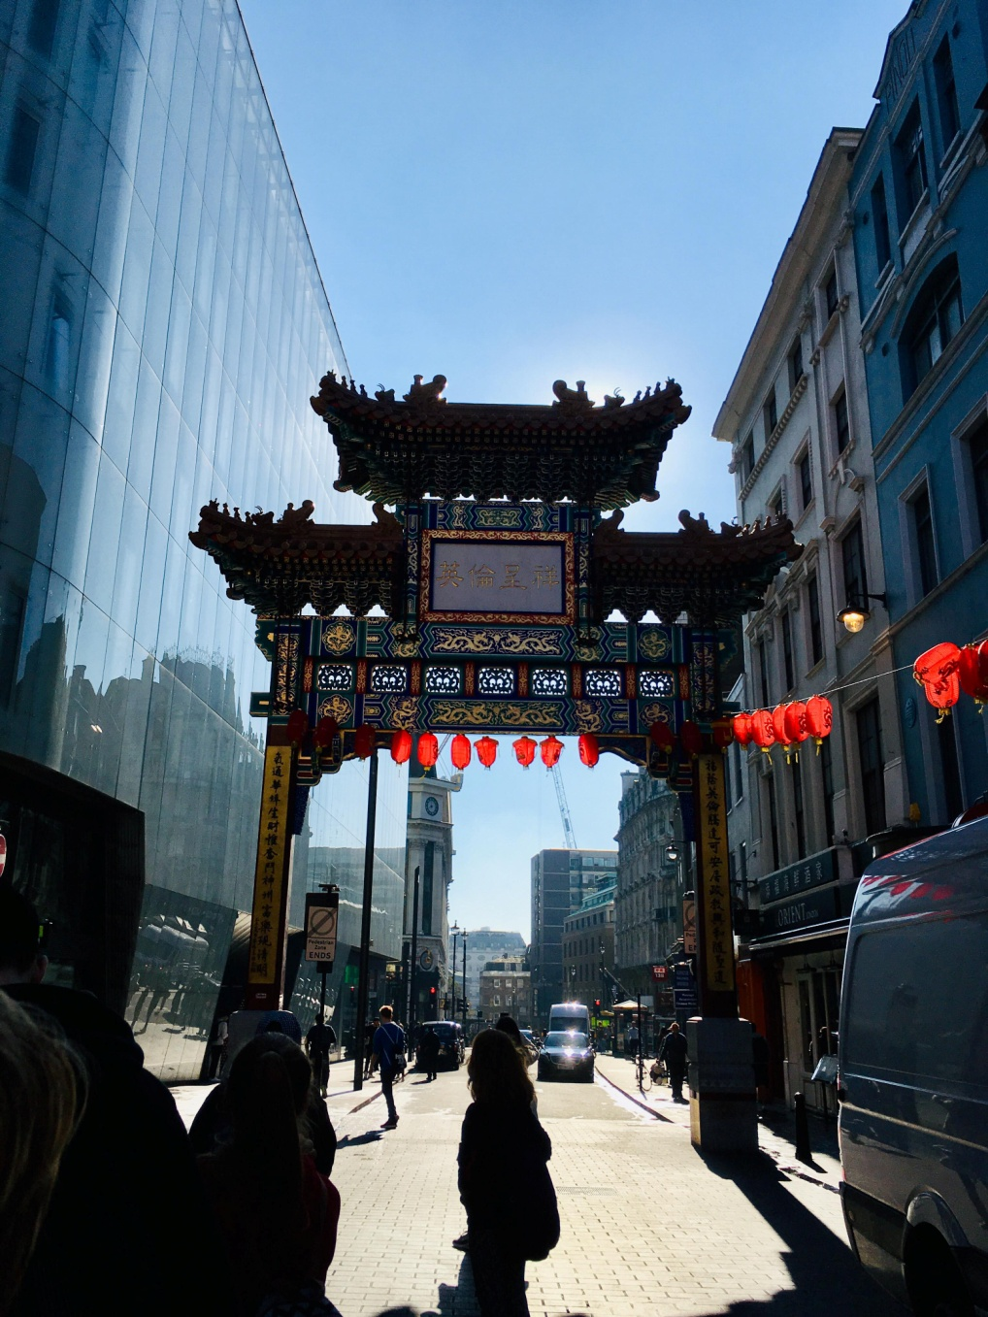
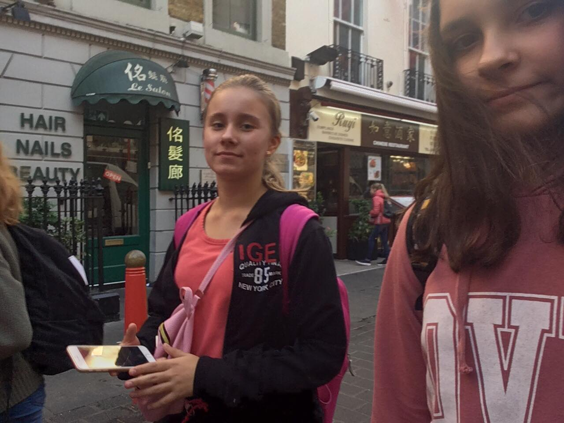
Chinatown
It was long.
It was very dead.
The street name was written in Chinese.

Slide 6
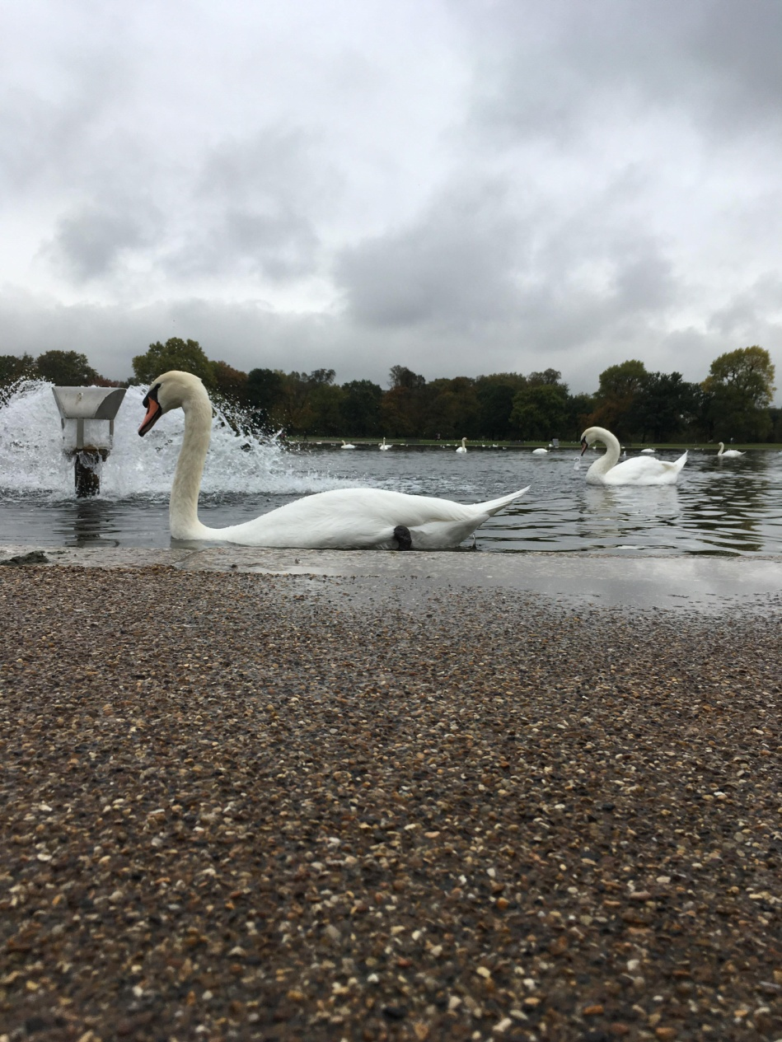
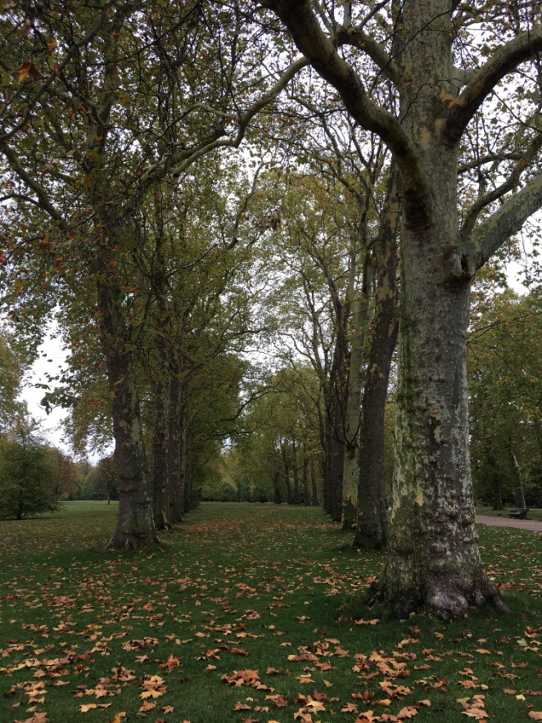
Kensington gardens
They are beautiful.
There were a lot of swans

Slide 7
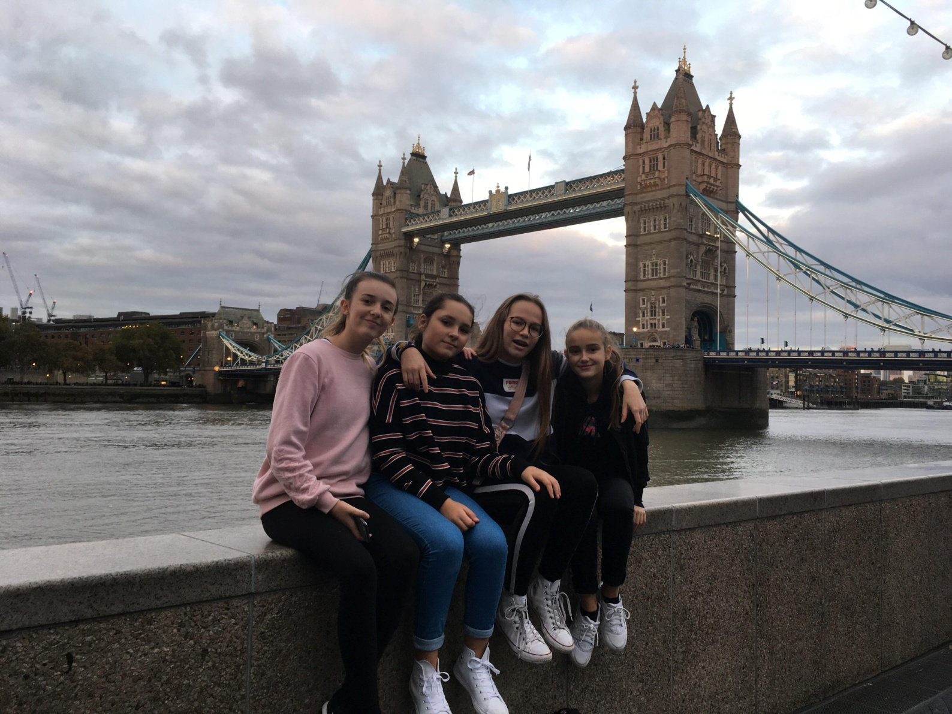
Thank you for watching.

