Slide 1
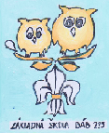
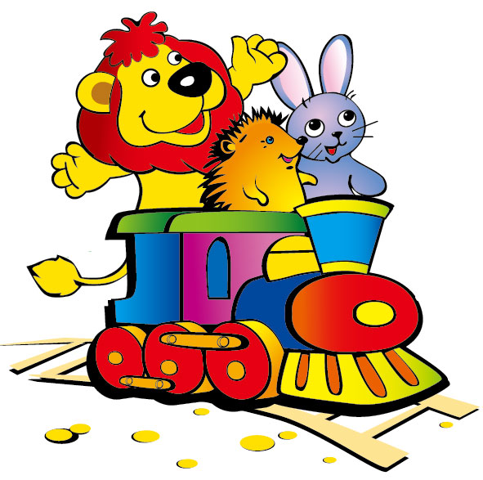
TOYS

Slide 2
What is it?

Slide 4
What is it?

Slide 5
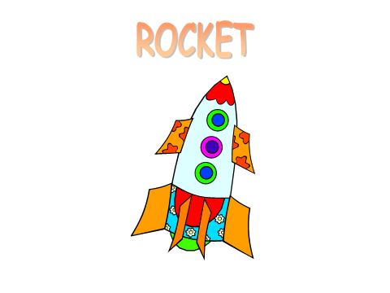

Slide 6
What is it?

Slide 7
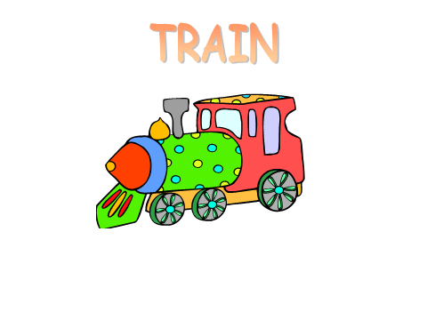

Slide 8
What is it?

Slide 9
PLANE

Slide 10
What is it?

Slide 11
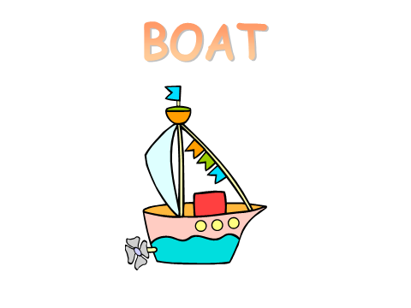

Slide 12
What is it?

Slide 13
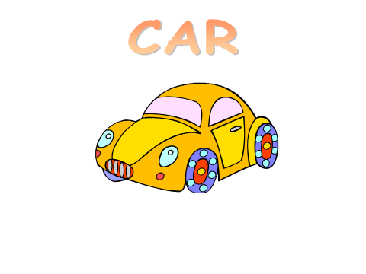

Slide 14
What is it?

Slide 15
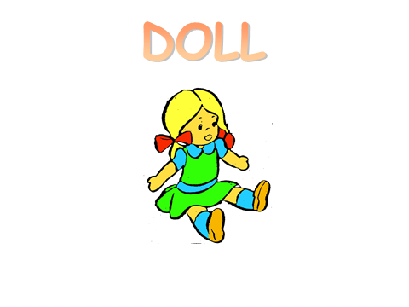

Slide 16
What is it?

Slide 17
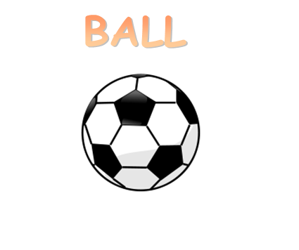

Slide 18
What is it?

Slide 20
What is it?

Slide 21
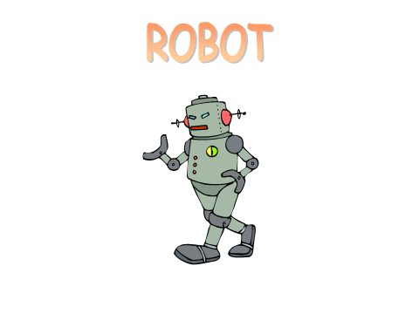

Slide 22
What colour is it?

Slide 23
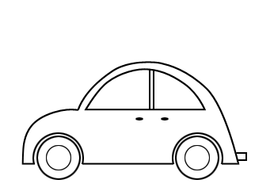
What colour is it?

